Slide 1
A Survey of Rerank for Code Generation
Jia Li (♂)
2023.2.28
Notes:
我最近看了一些有关利用rerank技术来提升代码生成效果的论文，今天简单地总结一下，分享给大家。

Slide 2
Abstract
Motivation: Large-scale language models (LLMs) can output extensive candidates on code generation. How to select a correct programs from these candidates is challenging.
Approach:
We survey six related papers and divide them into two groups, including (I) Execution-based Clustering and (II) Neural Ranker.
We discussion some limitations of existing approaches and further directions.
Notes:
Reran技术的motivation是…
那在本次汇报中，我会…

Slide 3
Introduction
Large language models (LLMs) have demonstrated an impressive ability to generate programs for various programming tasks.
In practice, LLMs can generate a correct program for a task when given numerous trials (e.g., 100).
Thus, a recent trend is to do large scale sampling of candidates and then filtering/ranking the candidates to select a best program.
Notes:
首先是背景介绍。
大规模语言模型已经在代码生成上…
在实际场景中，可以通过不断地采样来从大模型中获取正确答案
因此，一个趋势就是，先从大模型里采样出很多候选，然后再筛选出其中最好的一个程序最为输出答案

Slide 4
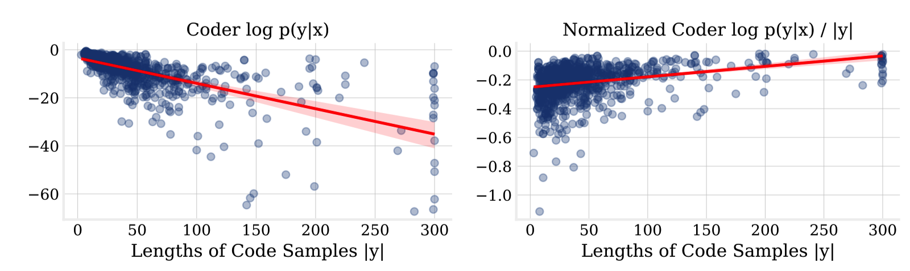
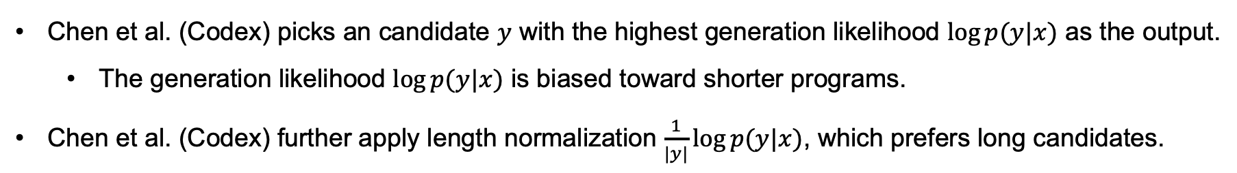
Introduction
Chen et al. (Codex) picks an candidate $y$ with the highest generation likelihood $\log{p(y|x)}$ as the output.
The generation likelihood $\log{p(y|x)}$ is biased toward shorter programs.
Chen et al. (Codex) further apply length normalization $\frac{1}{|y|}\log{p(y|x)}$, which prefers long candidates.
Notes:
最早，Codex中将大模型的生成概率作为筛选的标准，但它倾向于…
之后，作者有进一步用长度来归一化概率。但发现它倾向于…
因此，后续有一些的工作去研究更有效的rerank方法，来提升大模型的性能。

Slide 5


Overview
Test-based Clustering
AlphaCode (2022), MBR-EXEC (2022), CodeT (2022)
Test cases
output
Executor
Clustering
Input requirement
Language Model
candidates
0.95
…
0.21
output
Neural network
Probability
Neural Ranker
CodeRanker (2022), Coder-Reviewer (2022), LEVER (2023)
Notes:
这里，展示了近来rerank方法的整体流程。它们首先都是从大模型采样出很多的候选。
我将现有的方法大致分为两类。
第一类是基于执行的聚类方法。这类方法将候选在test cases上运行，并基于运行的结果对候选进行聚类，然后一个或多个类中挑选最终的输出。代表工作有AlphaCode…
第二类是神经网络ranker。它们直接利用一个神经网络来预测一个候选是否是正确的。基于正确的概率来对候选进行排序。代表工作有…

Slide 6
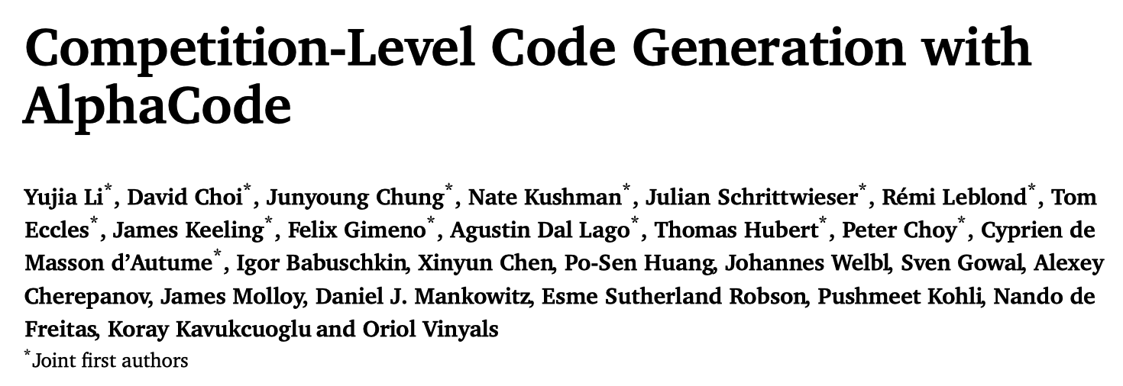

Slide 7
Test-based Clustering - AlphaCode
﻿AlphaCode selects outputs from extensive candidates in two steps.
Filtering. Keeping candidates that pass public test cases.
Clustering.
Training a test input generation model and collecting many test inputs.
Feeding test inputs to candidates and obtaining their outputs.
Clustering candidates that have the same outputs.
Selecting one program from each cluster from largest to smallest clusters.
Notes:
首先是AlphaCode，它分两步去从候选中挑选答案…

Slide 8
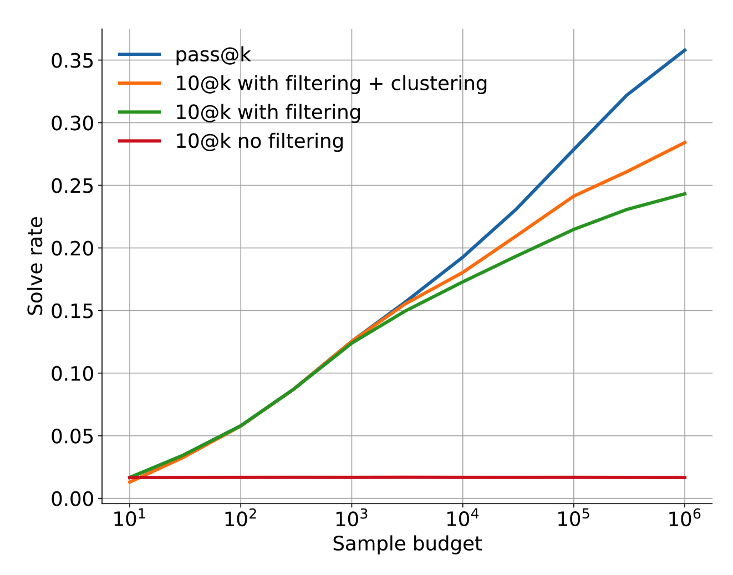
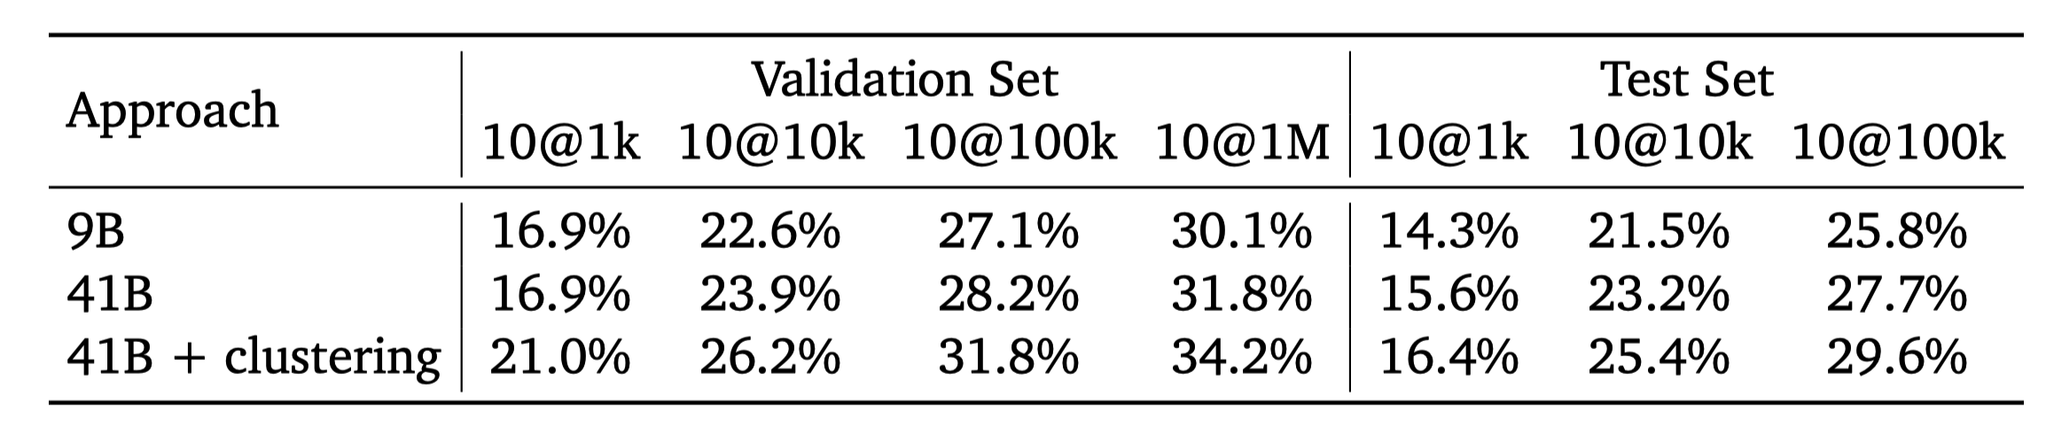
Test-based Clustering - AlphaCode
Results on the CodeContests dataset.
Upper bound
Notes:
这里展示了在CodeContests上的结果。
结果表明（1）AlphaCode的这种聚类方法可以有效的提升模型的准确率。（2）消融分析也表明，每一步都有一定的贡献。

Slide 9
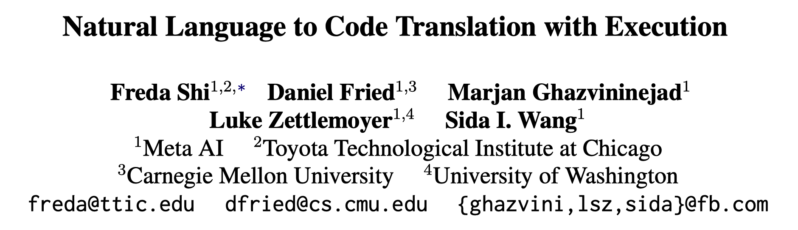
EMNLP 2022

Slide 10
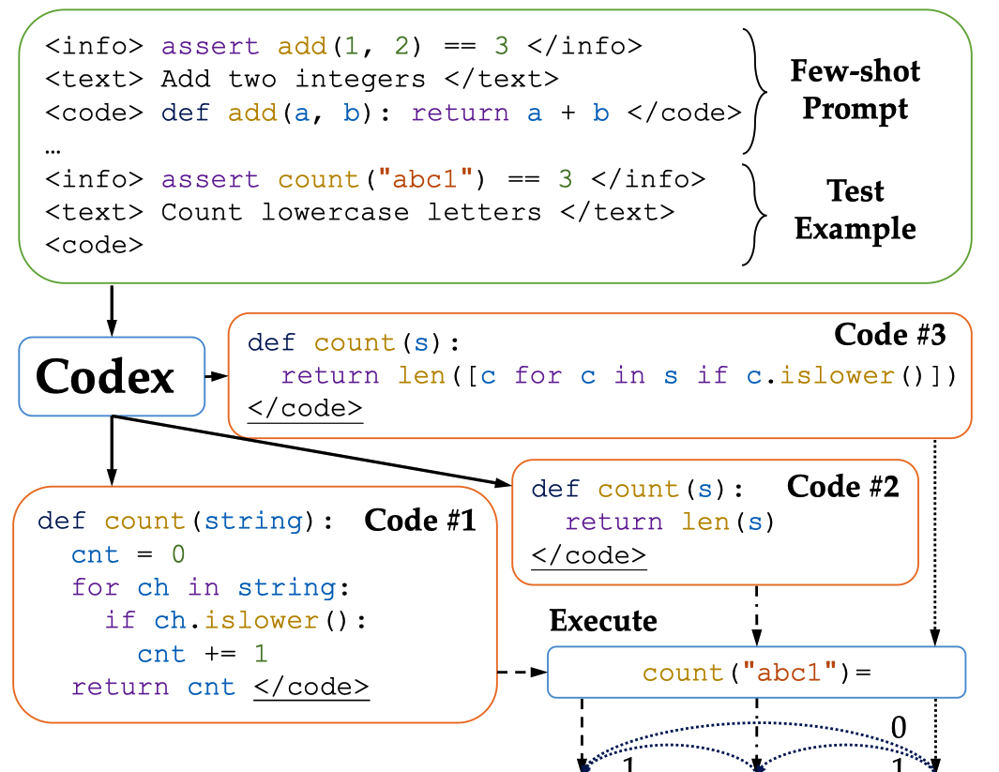
Test-based Clustering - MBR-EXEC
﻿MBR-EXEC selects outputs from extensive candidates in two steps.
Execution. Collecting outputs of candidates on several public test inputs.
Clustering. Clustering candidates based on their outputs and selecting a program from the largest cluster.
Code #1 Code #3
Code #2
Notes:
第二个方法是MBR，它也是分两步挑选输出。

Slide 11
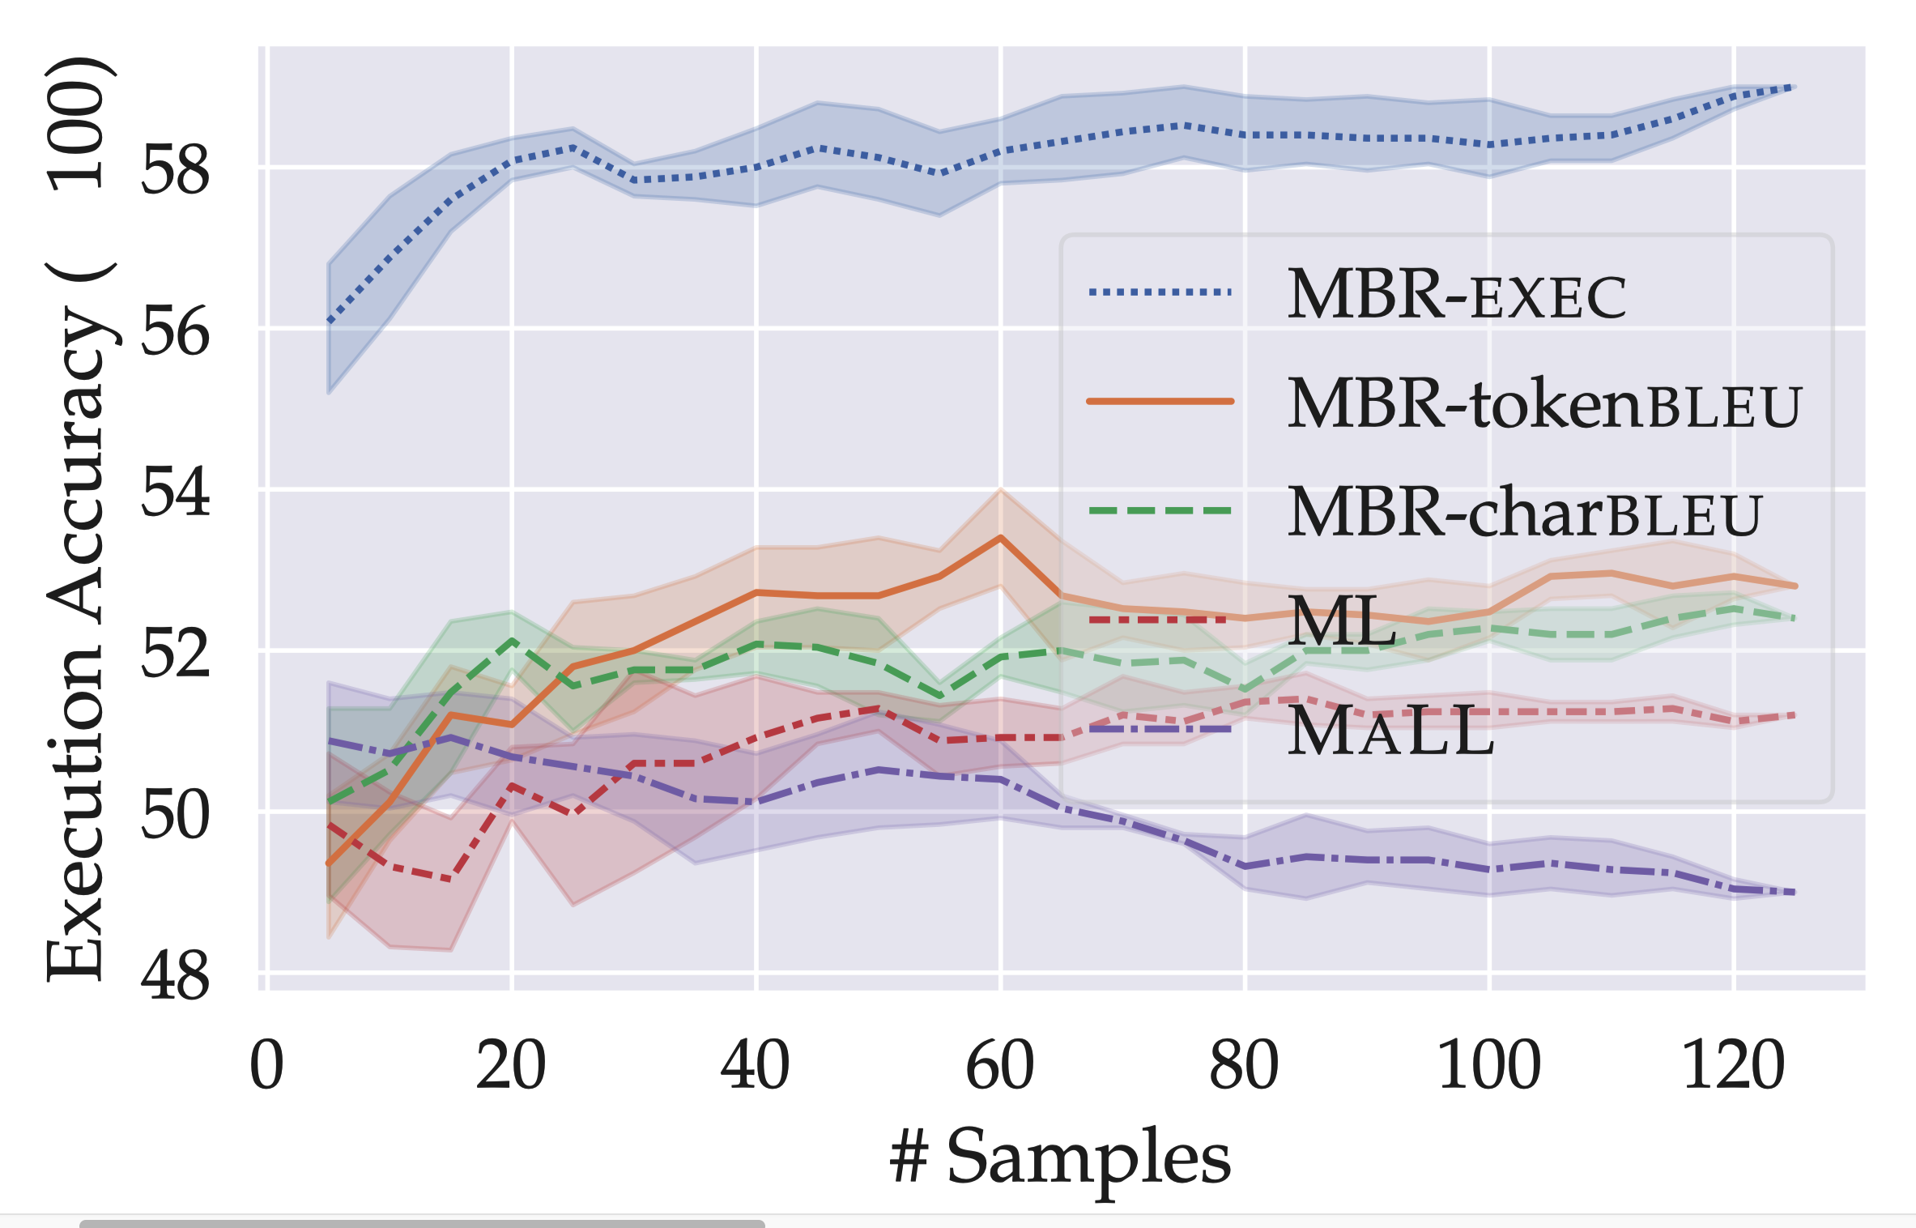
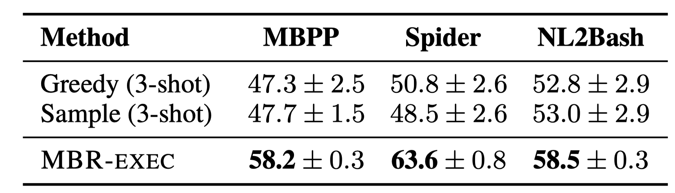
Test-based Clustering - MBR-EXEC
# Pass@1
Comparison between MBR-EXEC and baselines without rerank.
Comparison between MBR-EXEC and other rerank approaches on the MBPP dataset.
MBR-tokenBLEU/charBLEU: two variants of MBP-EXEC using BLEU to cluster candidates
ML: generation likelihood
MALL: normalized ML
Notes:
这里展示了MBR在三个数据集上的效果。
（1）相比于没有rerank，直接贪心或者随机采样，MBR…
（2）作者进一步和其他的rerank方法进行了对比。包括：最直接的生成概率和长度归一化后的生成概率。以及两个本文方法的变体，采用BLEU值来聚类候选。
结果表明：本文方法的效果最好，使用生成概率的效果最差。本文方法的两种变体，虽然效果有所下降，但仍然由于基于生成概率的方法。

Slide 12
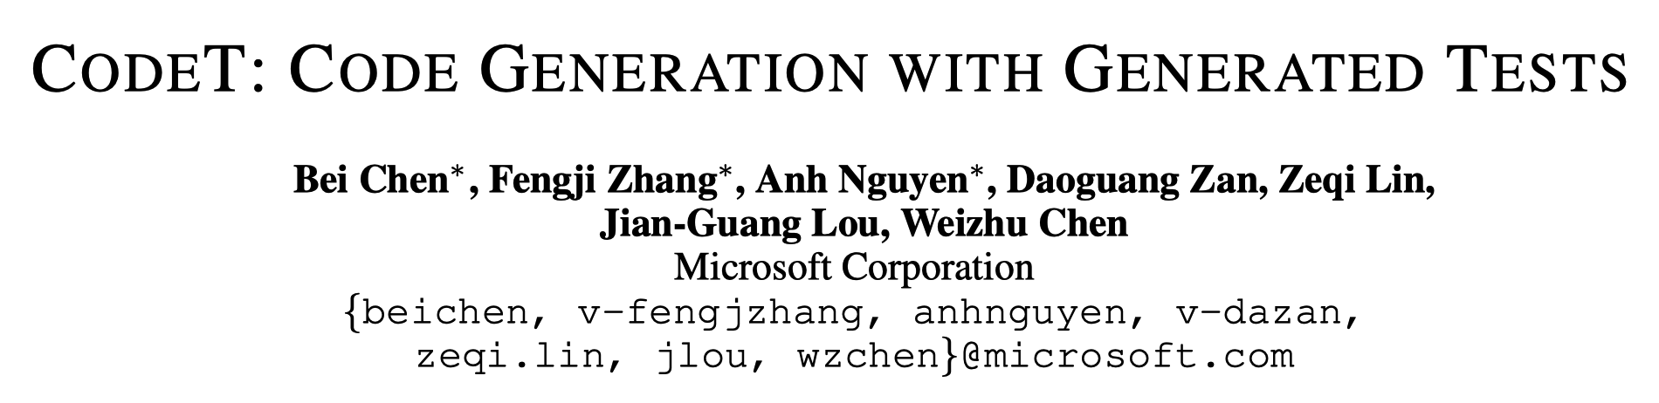

Slide 13
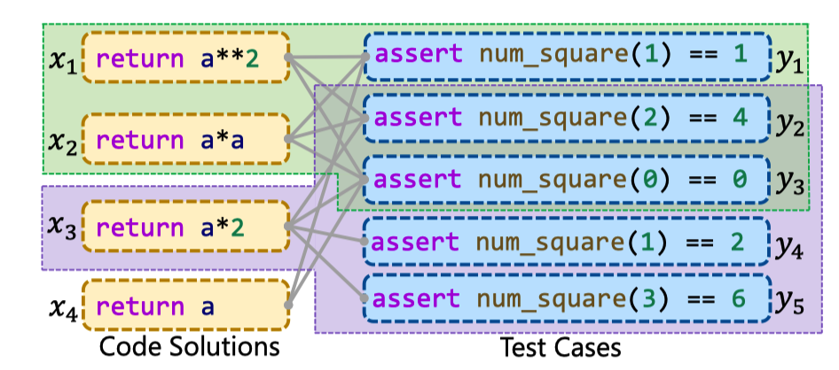
Test-based Clustering - CodeT
﻿CodeT selects outputs from extensive candidates in three steps.
Test Generation. Using a LLM to generation test cases.
Execution. Collecting outputs of candidates on several public test cases.
Clustering. Clustering candidates based on their outputs and computing a score for each cluster. Selecting a program from the cluster with the highest score.
Cluster 1 (green)
Score: 2*3 = 6
Cluster 2 (purple)
Score: 1*4 = 4
Cluster 3 (white)
Score: 1*2 = 2
Notes:
第三个工作是CodeT。它的思路跟MBR类似，不同的是，它是利用一个LLM来生成test cases。具体来说，分为三步…
下图是一个CodeT的例子。

Slide 14
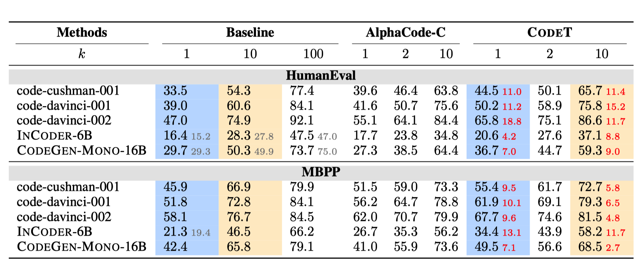
Test-based Clustering - CodeT
Without rerank
Notes:
这里展示了CodeT在两个数据集上的结果。
Baseline指的是…
可以看出，CodeT效果最好，超越了之前的rerank方法。

Slide 15
Test-based Clustering
These approaches use (generated or human-written) test cases to cluster candidates and select outputs from several clusters.
Why it works.
LLMs are powerful and can generate many correct programs with a large-scale sampling.
Among sampled candidates, correct programs show a consistent behavior. While wrong programs are often diverse and have different behaviors.
Thus, we can use test cases to find consensus among candidates, which is likely to be correct.
Notes:
这里简单地总结一下。上述的工作都是采样测试用例来聚类候选，然后从一个或多个类中挑选程序作为输出。
我当初看到这里的时候，有个疑问就是为什么这样的方法会work，特别是CodeT它使用的还是生成测试用例。
这里我提供了一些可能的原因。…

Slide 16
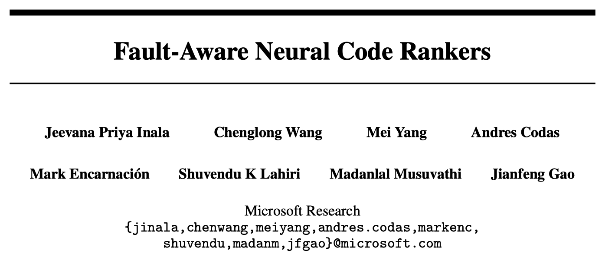
NIPS 2022

Slide 17
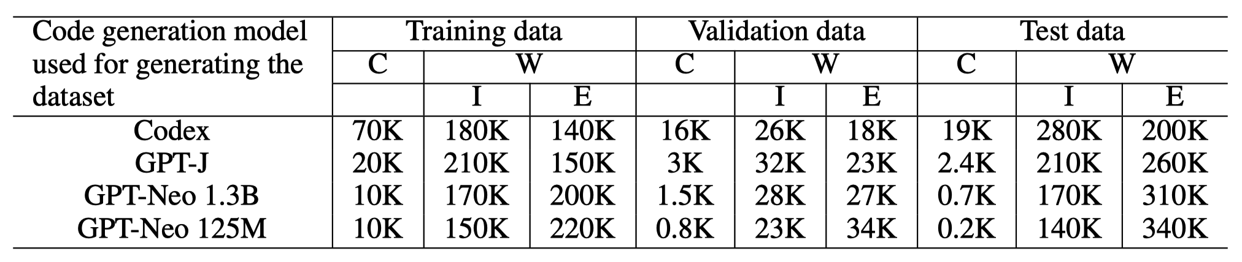
Neural Ranker - CodeRanker
﻿CodeRanker (172M) is a neural classifier that is trained to classify a candidate as correct or not.
Input: input requirement, a candidate.
Output: correct or wrong label
Authors also design some variants of CodeRanker. For example, they split the wrong label into multi-class labels (e.g., 11 execution errors).
Authors collect extensive candidates on the APPS-train and run candidates on test cases, to construct the training data of CodeRanker.
The training data generated using 4 code generation models on the APPS dataset.
Notes:
下面是第二类方法，基于神经网络的ranker。
第一个代表工作是CodeRanker，它是一个神经网络分类器，用来预测一个候选是否符合需求的。
CodeRanker的输入是…输出是…
作者还进一步设计了一些CodeRanker的变体，例如将wrong label进一步细分为11类具体的执行错误，让CodeRanker去预测候选具体是哪一类执行错误。
作者利用APPS的训练集来构造CodeRanker的训练数据…

Slide 18
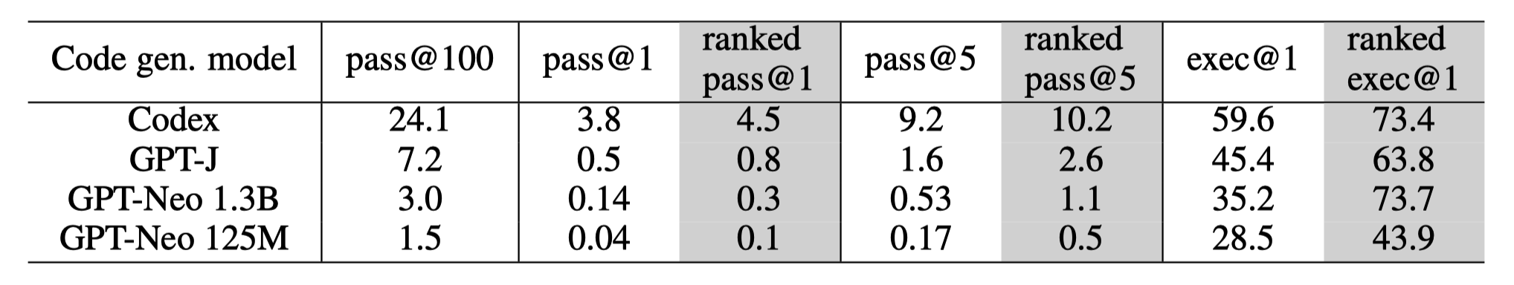
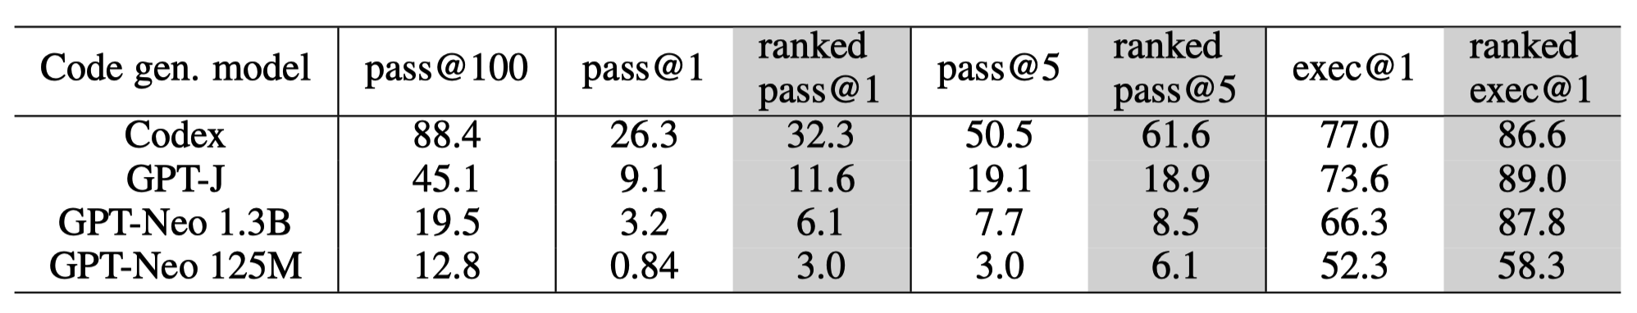
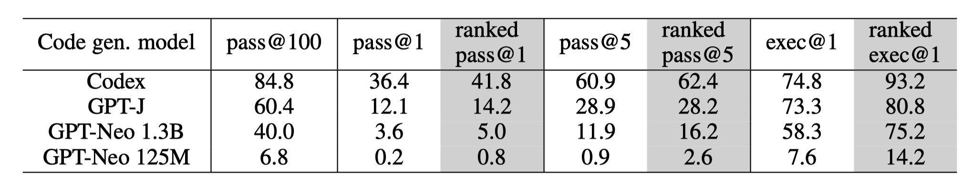
Neural Ranker - CodeRanker
Results on the APPS dataset.
Results on the HumanEval dataset.
Results on the MBPP dataset.
Notes:
这里展示了CodeRanker在三个数据集上的结果。
可以看出，CodeRanker有效地提升的多个模型的准确率，但它并没有和其他rerank方法去对比。

Slide 19
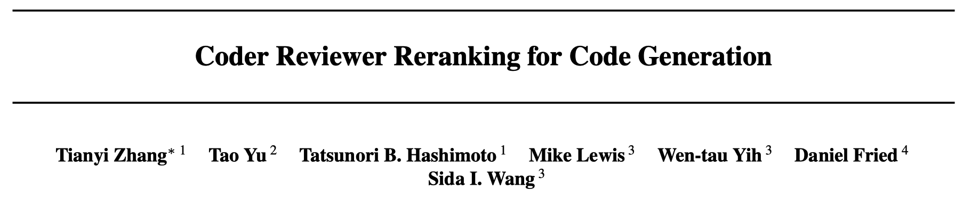

Slide 20
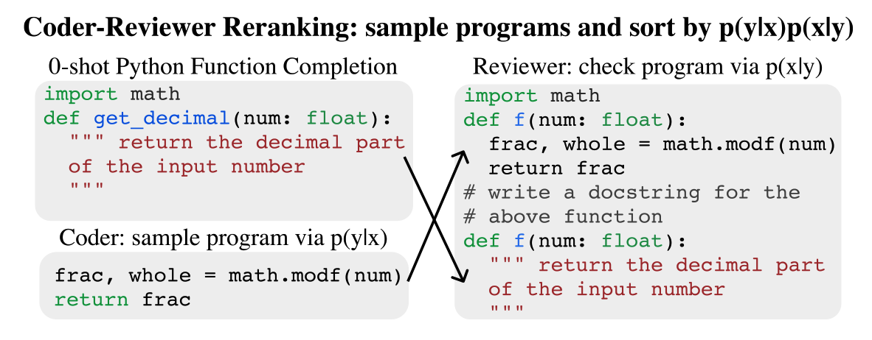
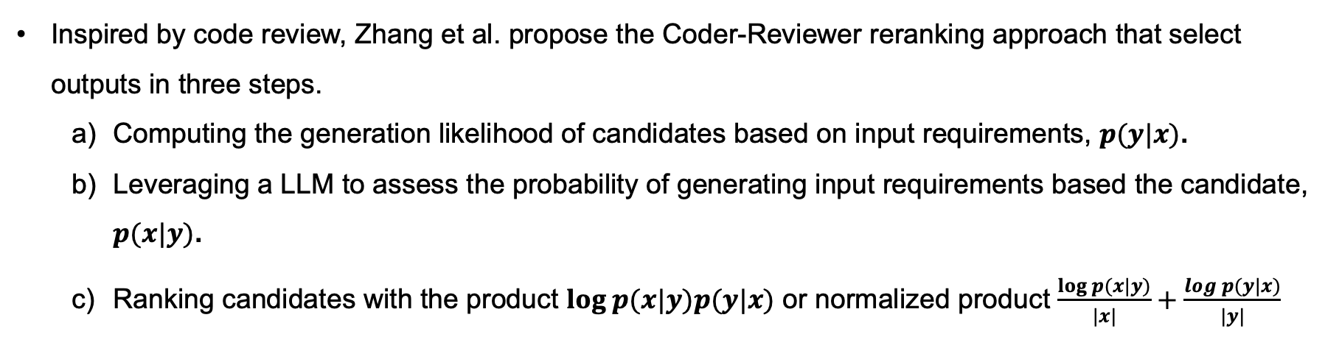
Neural Ranker – Coder-Reviewer
﻿Inspired by code review, Zhang et al. propose the Coder-Reviewer reranking approach that select outputs in three steps.
Computing the generation likelihood of candidates based on input requirements, $p(y|x)$.
Leveraging a LLM to assess the probability of generating input requirements based the candidate, $p(x|y)$.
Ranking candidates with the product $log p(x|y)p(y|x)$ or normalized product $\frac{\log{p(x|y)}}{|x|}+\frac{\log{p(y|x)}}{|y|}$
Notes:
第二个代表工作是Coder-Reviewer。这个方法的motivation来源于软件开发中的code review过程。
具体分为三步，首先…
下面展示了一个例子。

Slide 21
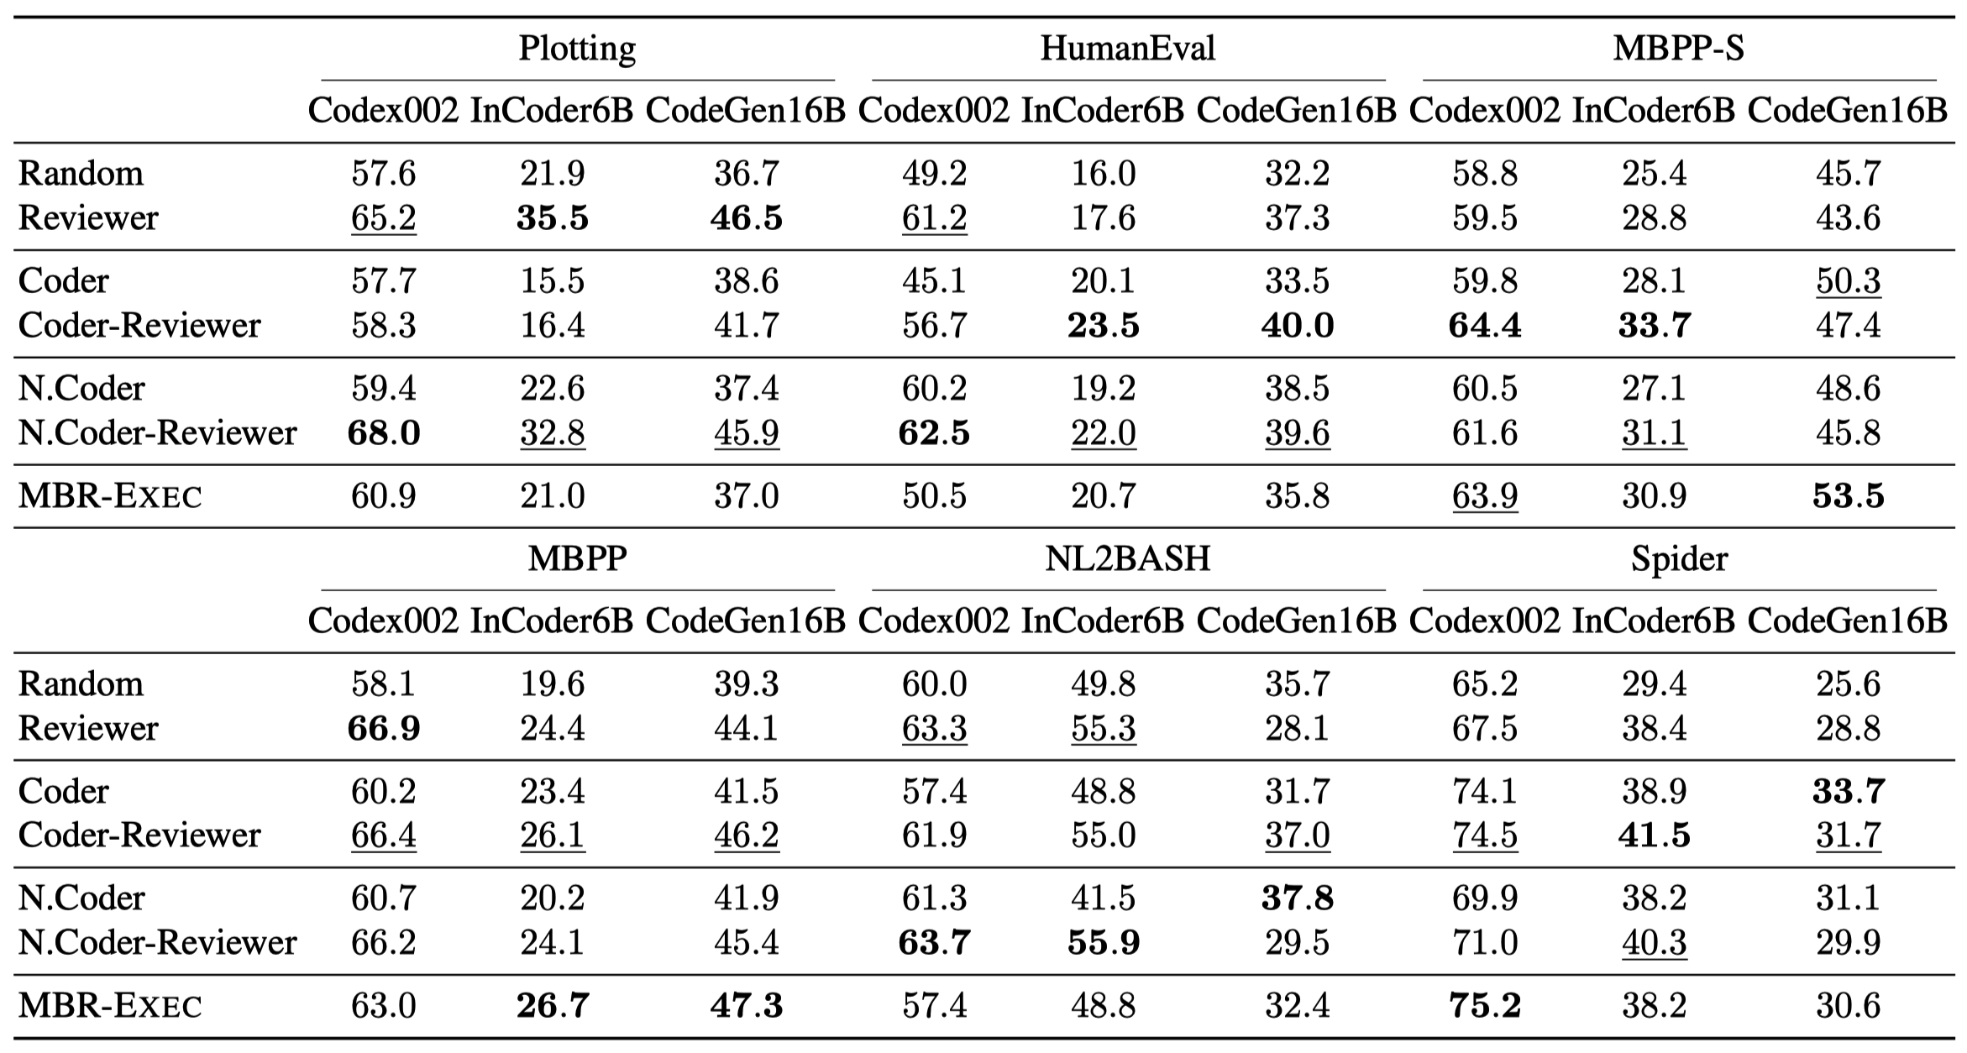
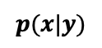
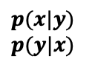
Neural Ranker - CodeRanker
$$p(x|y)$$
$p(x|y)$ $p(y|x)$
normalized
Notes:
这里展示了Coder-Reviewer及其变体在六个数据集上的结果。
解释一些变体…
总体来看，Coder-Reviewer及其变体在六个数据集上取得了最好的效果。

Slide 22
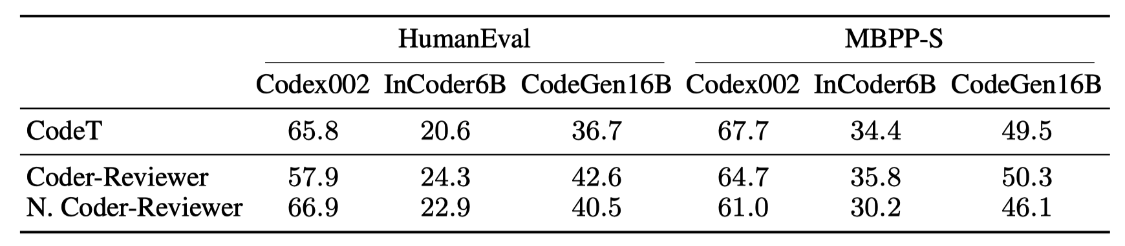
Neural Ranker - CodeRanker
Notes:
作者还和CodeT进行了对比…

Slide 23
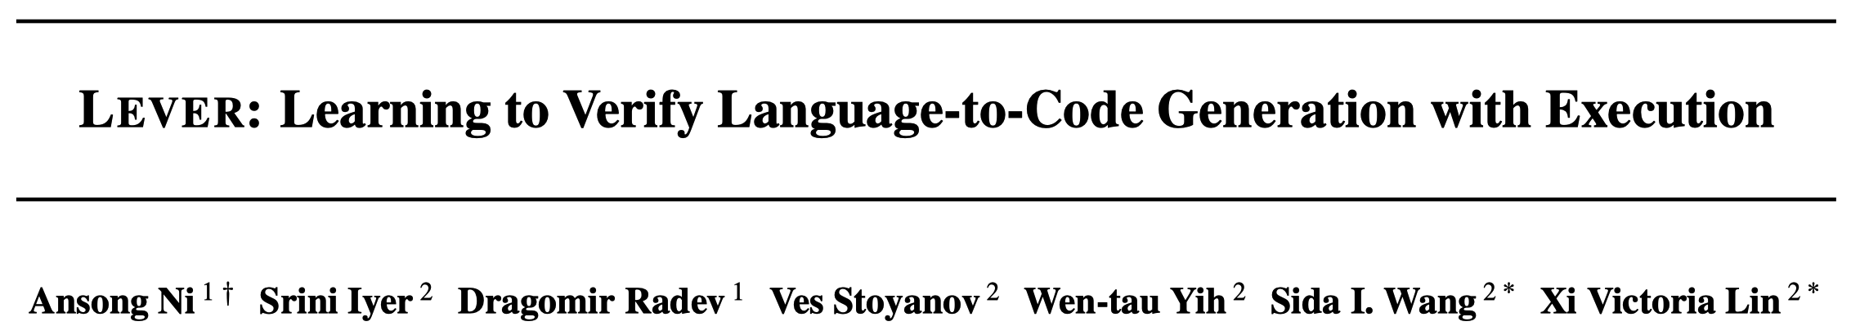

Slide 24
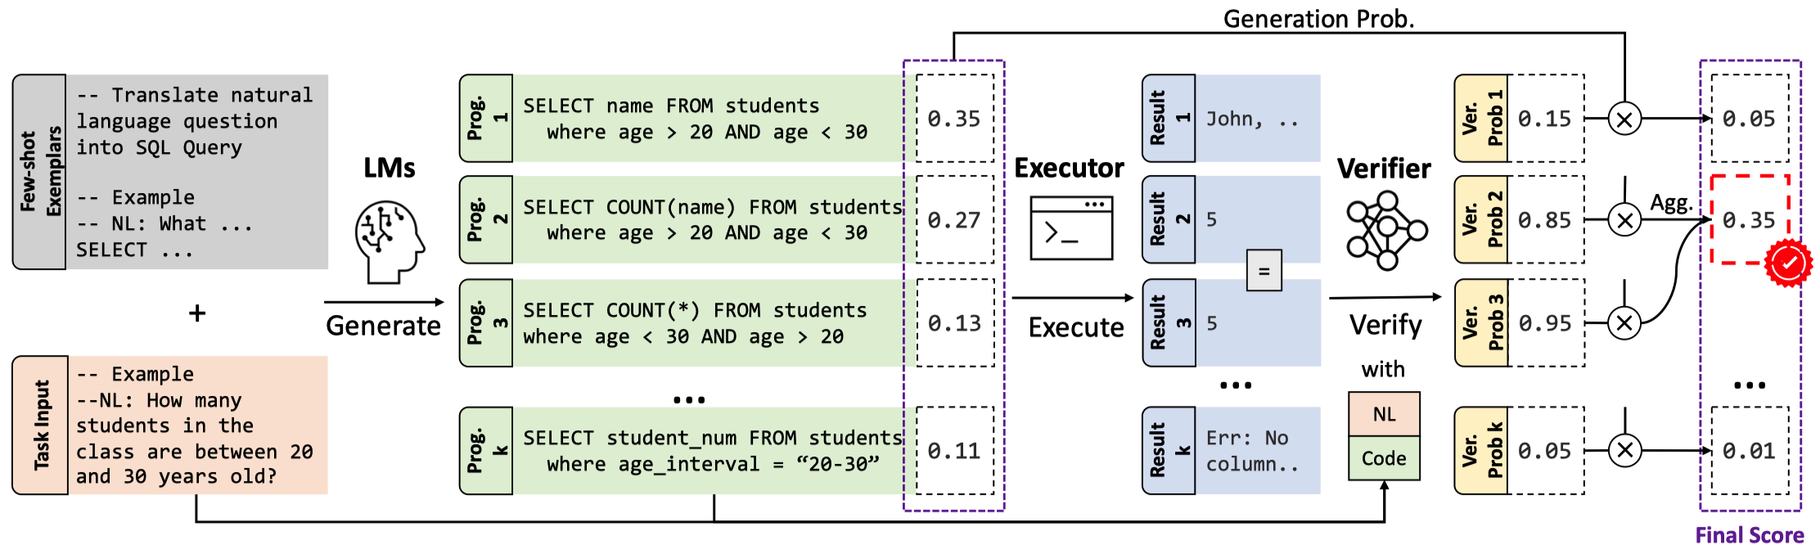
Neural Ranker – LEVER
﻿LEVER (220M-770M) is a neural verifier that is trained to classify a candidate as correct or not.
Input: input requirement, an candidate, execution results.
Output: correct or wrong.
Notes:
最后一个是最近提出的LEVER…它的输入包括…
下图展示了LEVER的整体流程。首先在public test cases上执行。然后将执行结果…送入一个神经网络verifier，预测每个候选是正确的概率。最后会将执行结果一样的候选的概率聚合起来。

Slide 25
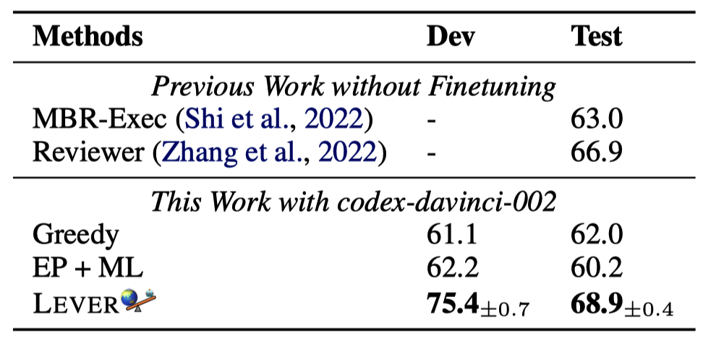
Neural Ranker - LEVER
Error Pruning + Maximum likelihood
Pass@1 on the MBPP dataset
Notes:
这里展示了LEVER在MBPP数据集上的结果。
结果表明：…

Slide 26
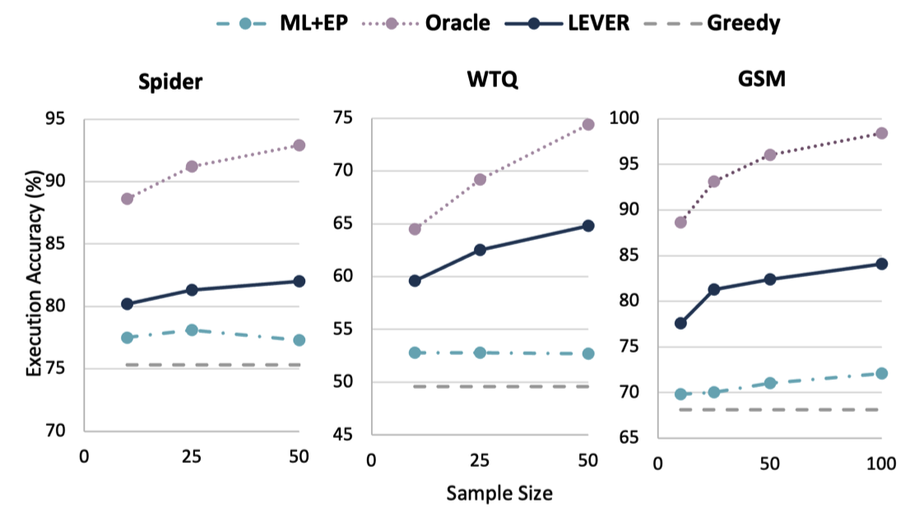
Neural Ranker - LEVER
Notes:
这里展示了LEVER在MBPP数据集上的结果。
结果表明：…

Slide 27
Conclusion
Rerank techniques can obviously improve the performance of LLMs on code generation.
Test-based Clustering: AlphaCode, MBR-EXEC, CodeT
Neural Ranker: CodeRanker, Coder-Reviewer, LEVER (SOTA)
Limitations
A large-scale sampling that is time-consuming.
Relying on test cases and run environments.
A neural ranker may fail in other domains or languages.

Slide 28

Future work
Learning to edit a small set of candidates into correct programs.
A paper in ICSE2023 found that existing code repair tools (e.g., Tbar, Recoder) can fix some auto-generated programs. But the performance is still low.

